Slide 1

Apex IT Skills Center Zafarwal
Course: Digital Marketing & E-commerce
Module 2: Digital Marketing
Facebook Page for Digital Products & AI Tools
Course Mentor: Jamshaid Akhtar

Slide 2






Understanding Digital Products vs Physical Products
What Are Digital Products?
Key Difference
Software tools
WordPress plugins
Very Important
Themes & templates
People don't fear the product — they fear wasting money
AI tools & subscriptions
Digital downloads
Therefore, trust and clarity matter more than price.

Slide 3










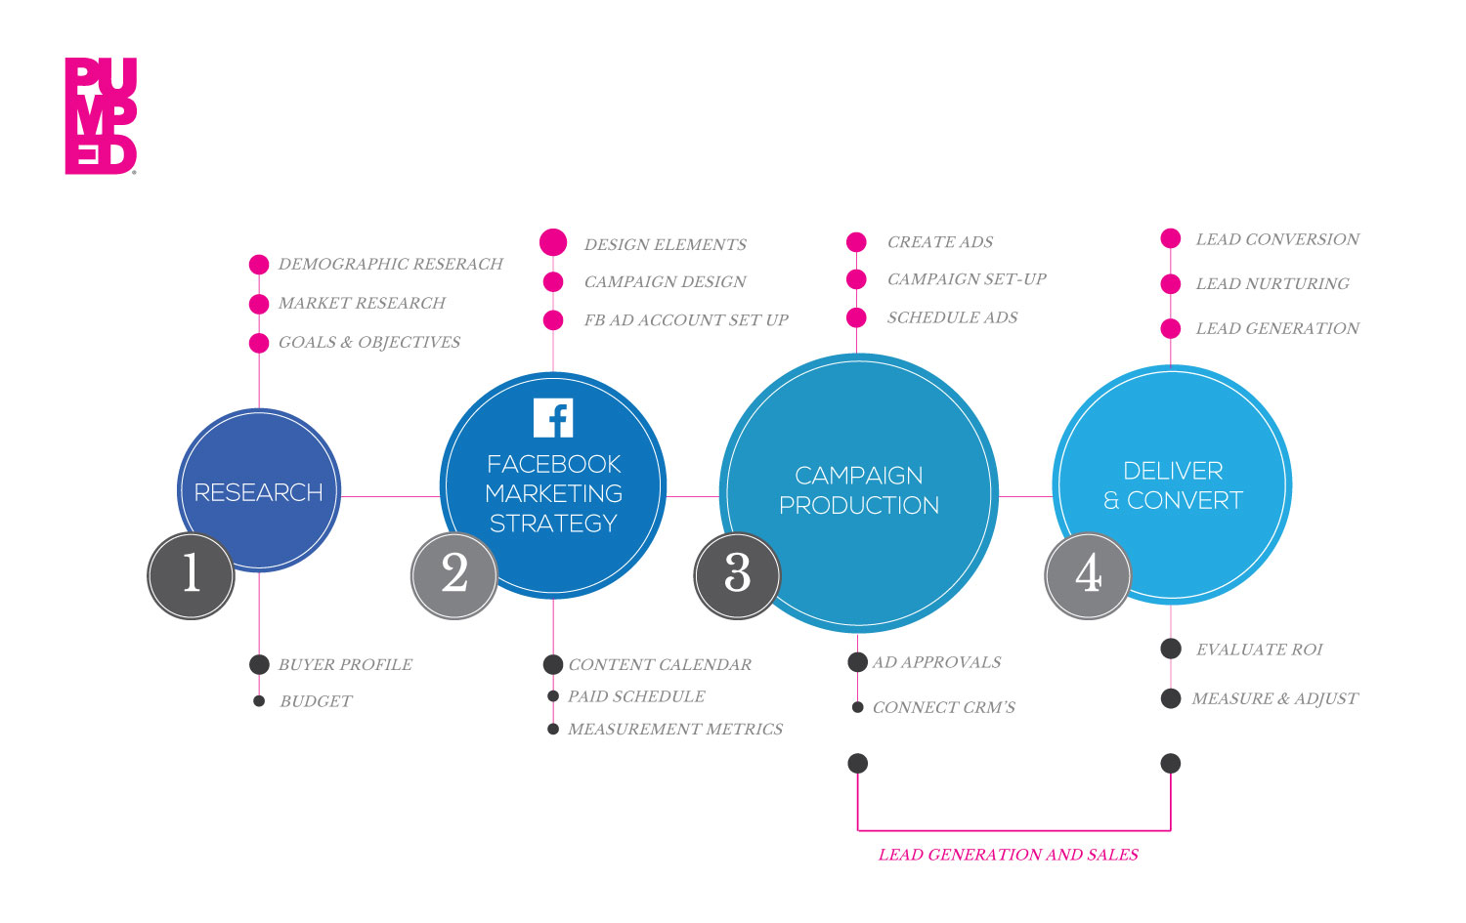

Facebook Page Positioning (Strategic)
Page Name Strategy
Category Selection
Bad Examples
Best Categories
"Cheap Digital Tools"
Software Company
"Best Plugins Store"
Internet Company
Digital Creator
Good Examples
IT Services
"Smart Digital Tools"
Avoid
"AI & Web Tools Hub"
"Pro Digital Solutions"
Random or unrelated categories
Why Names Matter
Names must suggest expertise, not cheap selling

Slide 4






Page Optimization for Digital Services
Visual Elements
About Section (Very Important)
Profile Picture
Structure
Clean logo
Who you help
What you provide
Tech-style design
Why you are trustworthy
How to contact
Simple colors (blue, black, white)
Cover Photo (Trust Builder)
Tools logos (WordPress, AI, design)
Sample
Clear value proposition
We provide verified digital tools, plugins, themes, and AI solutions for freelancers, businesses, and creators. All products are tested and supported. Message us for details.
Premium Digital Tools | AI Solutions | Website Assets
Message us for instant access

Slide 5






Trust Elements (Non-Negotiable)
Key Concept
For digital products, trust replaces touch
Clear Product Explanation
Demo Screenshots/Videos
Detailed descriptions of features, benefits, and use cases
Visual demonstrations showing product in action
Refund or Replacement Policy
Support Commitment
Clear terms if product doesn't meet expectations
Promise of assistance and problem resolution
Consistent Posting
Regular content showing active, engaged business

Slide 6










Facebook Algorithm Strategy for Digital Products
What the Algorithm Likes
What to Avoid
Educational Content
Direct Selling Every Post
Value-first approach builds authority
Overly promotional content reduces reach
Problem-Solving Posts
Spam Links
Address specific pain points of your audience
Excessive linking triggers spam filters
Video Demos
Copy-Paste Ads
Show products in action increases engagement
Duplicate content gets penalized
Comments & Questions
Interaction signals valuable content
Key Insight
Facebook's algorithm rewards engagement and value over direct sales. Focus on building trust first.

Slide 7

















Content Strategy for Digital Services Page
Education
Problem-Solution
Demo Content
"What is this tool?"
"Why your website is slow"
Screen recordings
"Who should use it?"
"How this plugin fixes it"
Before/after results
Teach, don't just sell
Show the transformation
Show, don't just tell
Trust Content
Sales Content
FAQs
Offers
Customer feedback
Bundles
Usage guides
Limited-time deals
Build credibility
Create urgency
Key Balance
80% value content (education, problem-solving, demo, trust) + 20% sales content = Optimal engagement

Slide 8




Sample Post Ideas (AIDA Framework)
Awareness
Interest
Struggling to design websites without coding?
Here's a tool most freelancers use.
A
This WordPress plugin helps you build pages in minutes.
Here's how it works.
I
Desire
Action
D
A
Our clients saved hours using this AI writing tool.
See the results.
Need this tool today?
Message us on WhatsApp for instant access.
AIDA Strategy
Guide customers through Awareness → Interest → Desire → Action to maximize conversion rates

Slide 9









Sales Funnel for Digital Products
Facebook Content
Educational posts build awareness and trust
Facebook Content
Trust Building
Trust
Value-first approach establishes credibility
WhatsApp
WhatsApp Conversation
Direct communication addresses concerns
Payment
Payment
Secure transaction with confirmation
Delivery
Delivery
Instant access to digital product
Why WhatsApp Works Best
Instant communication
Screenshots & demos
Payment confirmation
Support handling

Slide 10







Live Case Study & Common Mistakes
Case Study: "Pro Digital Tools Hub"
Key Teaching Takeaways
1
Page creation with strategic name
Authority positioning
Education > Discounts
2
Profile & cover optimization
3
About section writing with trust elements
4
First 3 posts: Educational, Demo, CTA
Trust before selling
Messaging > Links
Result: Professional and trustworthy page, not spammy
Hands-On Activity
Common Mistakes
Each student must:
Choose a digital product category
Selling pirated tools
Create a page name
Write About section
No support after sale
No explanation of product
Over-promising results

