Slide 1
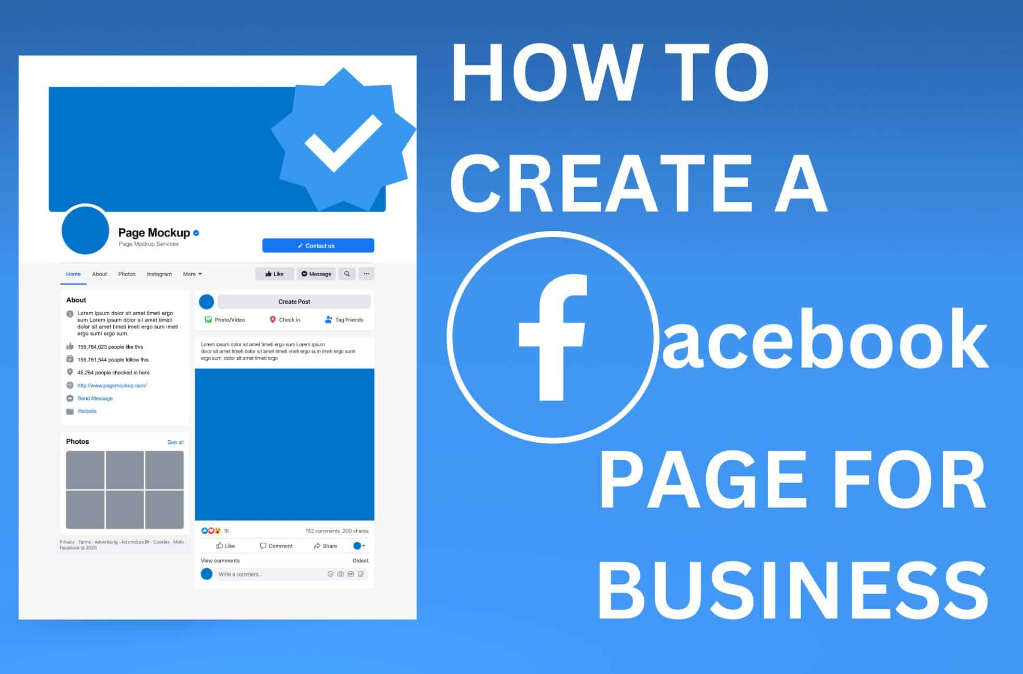

Business
How to Create a Professional Facebook Page
A Step-by-Step Guide to Building Your Business Presence on Facebook

Slide 2

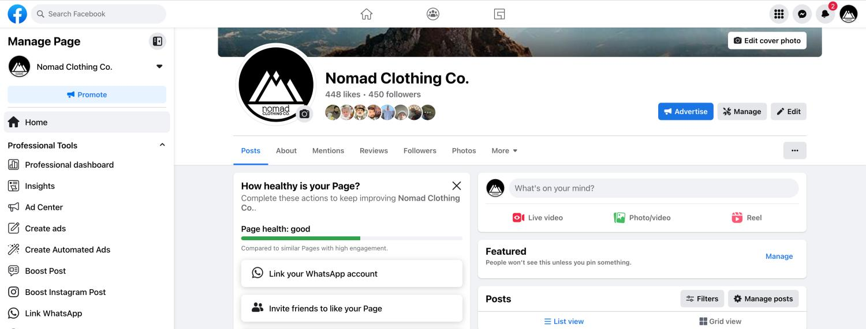



Why Create a Facebook Business Page?
Reach a Massive Audience Connect with billions of users worldwide
Build Trust & Credibility Professional presence enhances brand reputation
Powerful Marketing Tools Targeted ads, analytics, and promotional features
Direct Customer Service Instant communication through Messenger

Slide 3





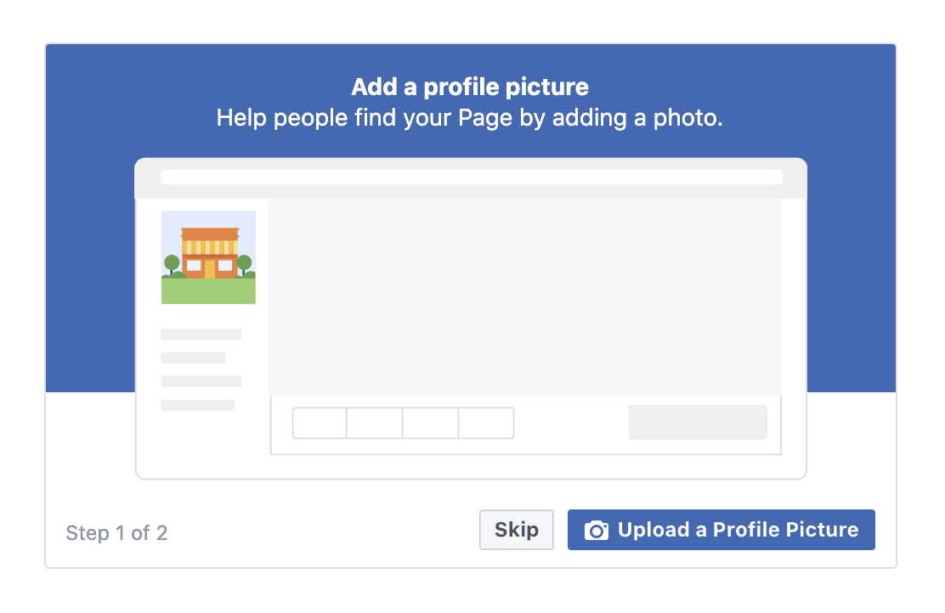



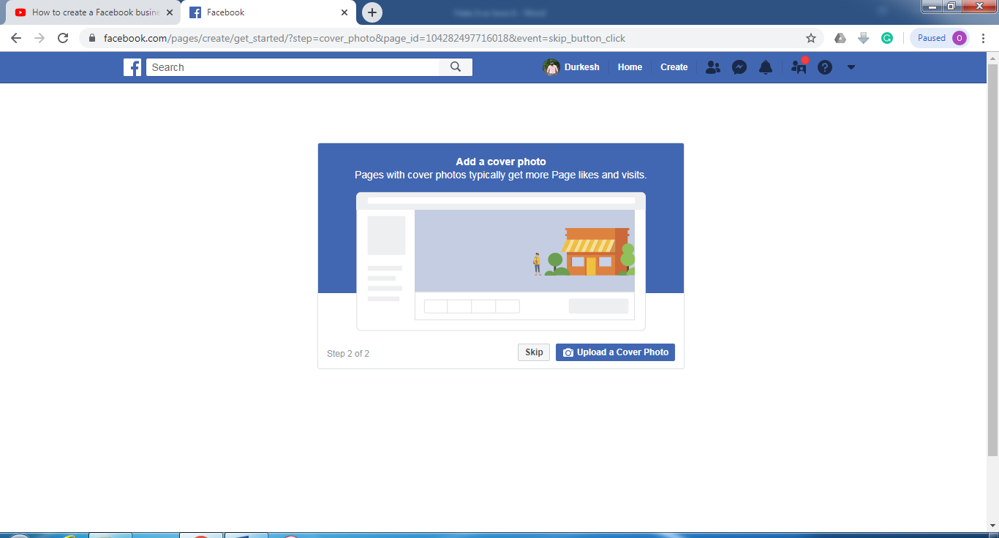

Preparation Before Creating Your Page
Required Information
Business Name - Official name customers know
Category - Type of business (up to 3)
Image Best Practices
Bio - Short description (255 characters)
Contact Details - Phone, email, website
Profile Picture
Location - Physical address (if applicable)
196 × 196 pixels (minimum)
Use your logo in a circular format
Business Hours - Operating schedule
Cover Photo
851 × 315 pixels (desktop)
640 × 360 pixels (mobile)
Keep important elements in the center for mobile view

Slide 4
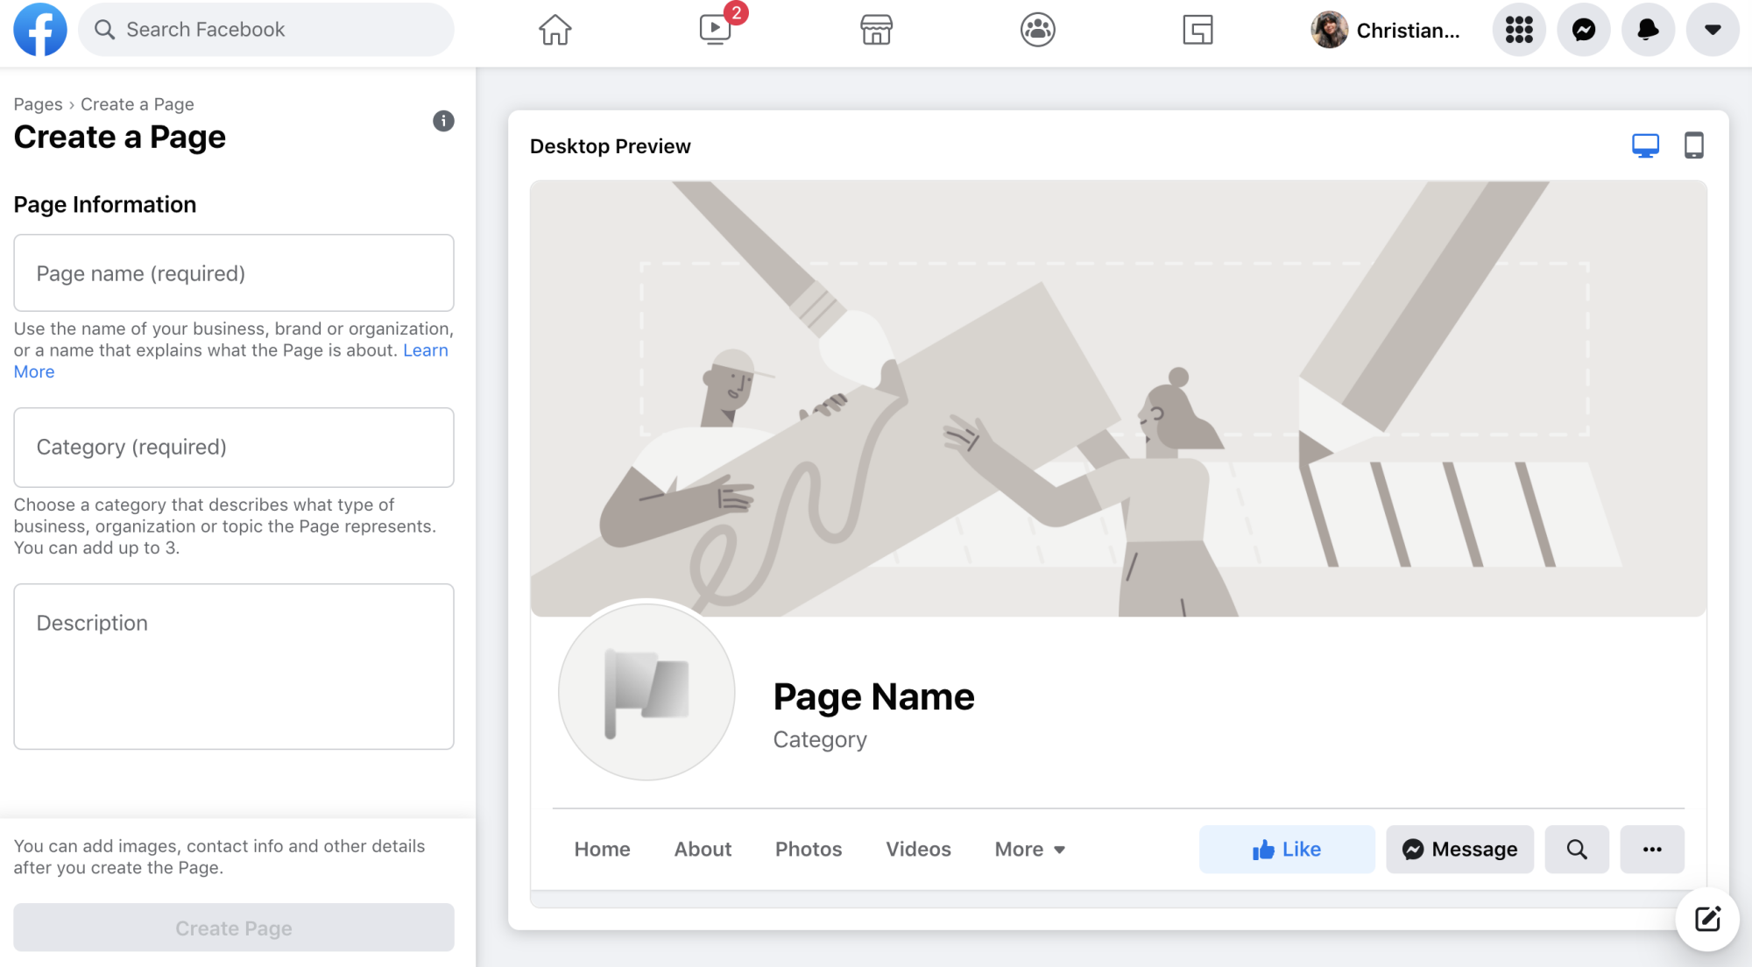





Step 1: Creating Your Page
01
Creating Your Page
Navigate to facebook.com/pages or click the menu icon
Click + Create New Profile or Page
Select Public Page and click Next
Enter your Page Name, Category, and Bio
Click Create Page to continue
Note: Your page name should match your business name for easy discovery

Slide 5

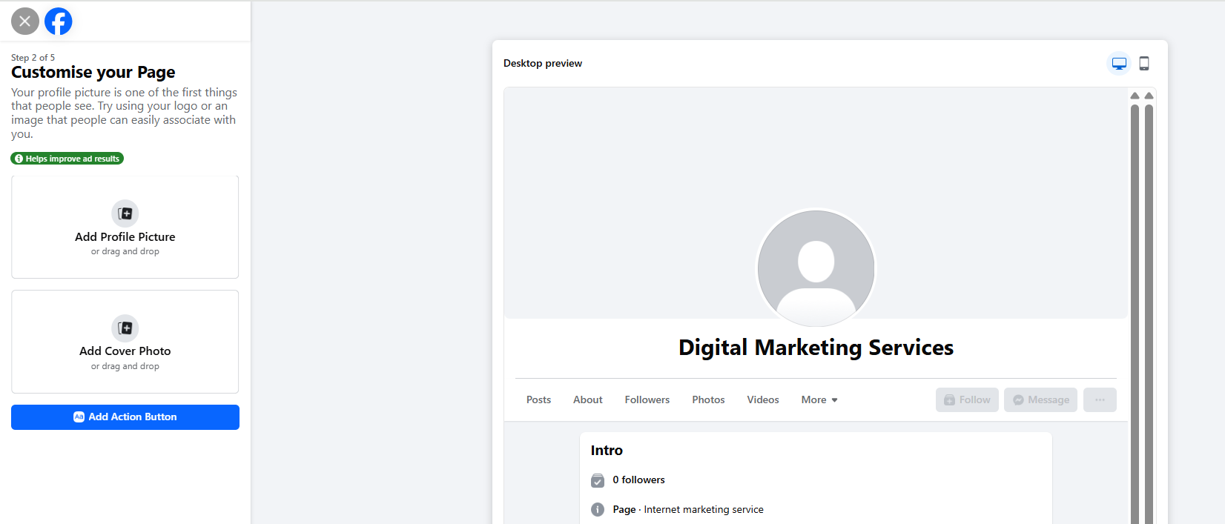





Step 2: Adding Profile Picture and Cover Photo
02
Profile & Cover Photos
Click Add Profile Picture to upload your logo
Click Add Cover Photo to upload your banner
Adjust positioning to ensure important elements are visible
Click Save when satisfied with positioning
Pro Tips
Profile: Use high-quality logo (196×196px minimum)
Cover: 851×315px for desktop, 640×360px for mobile
Keep important text in center for mobile compatibility

Slide 6

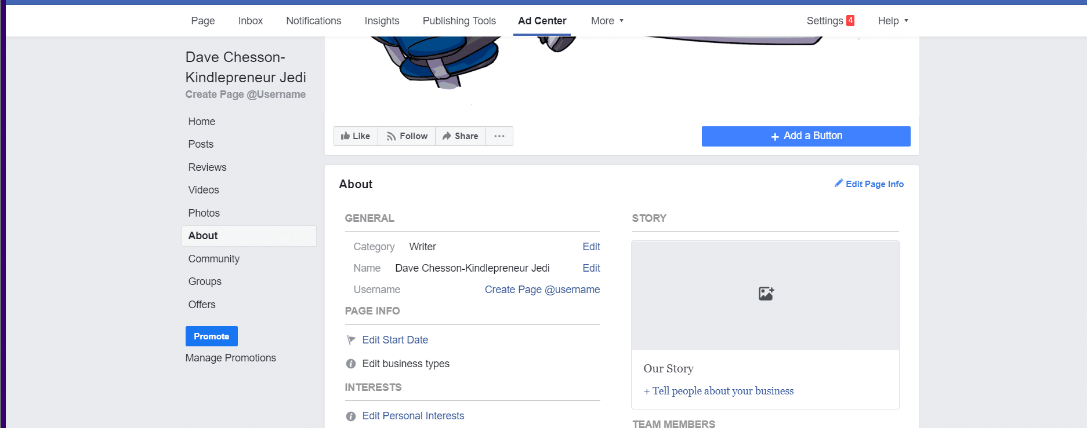





Step 3: Setting Up Page Details
03
Complete Your Page Information
Add your Website URL to drive traffic
Enter your Phone Number for direct contact
Provide your Business Email for inquiries
Set your Physical Address if applicable
Configure your Business Hours
Why Complete Information Matters
Builds trust with potential customers
Improves visibility in Facebook search
Enables features like location-based ads

Slide 7


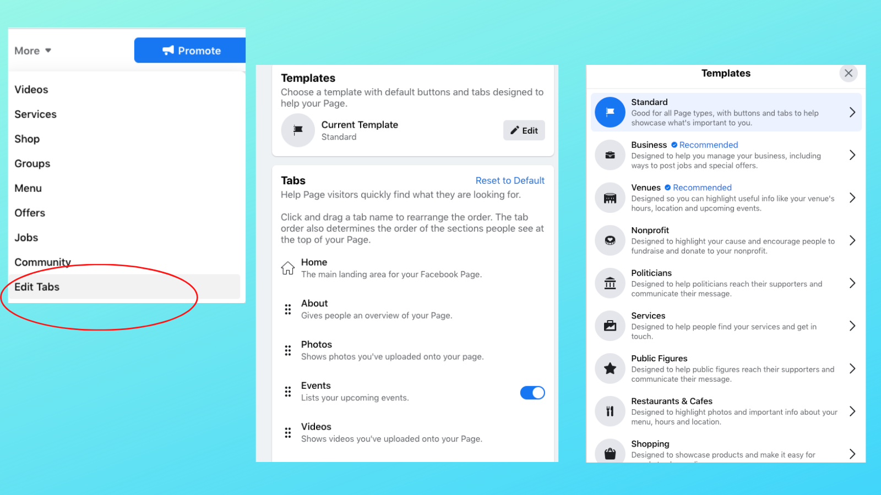









Step 4: Customizing Your Page
04
Personalize Your Page
Page Templates
Go to Settings > Templates and Tabs
Choose template: Business, Services, Shopping
Customize Tabs
Reorder tabs to prioritize important content
Hide tabs you don't need (e.g., Events)
Action Buttons (CTA)
Add a primary CTA button to your page header
Shop Now
Call Now
Send Message
Book Now
Pro Tip
Align your CTA button with your primary business goal (sales, leads, or appointments)

Slide 8

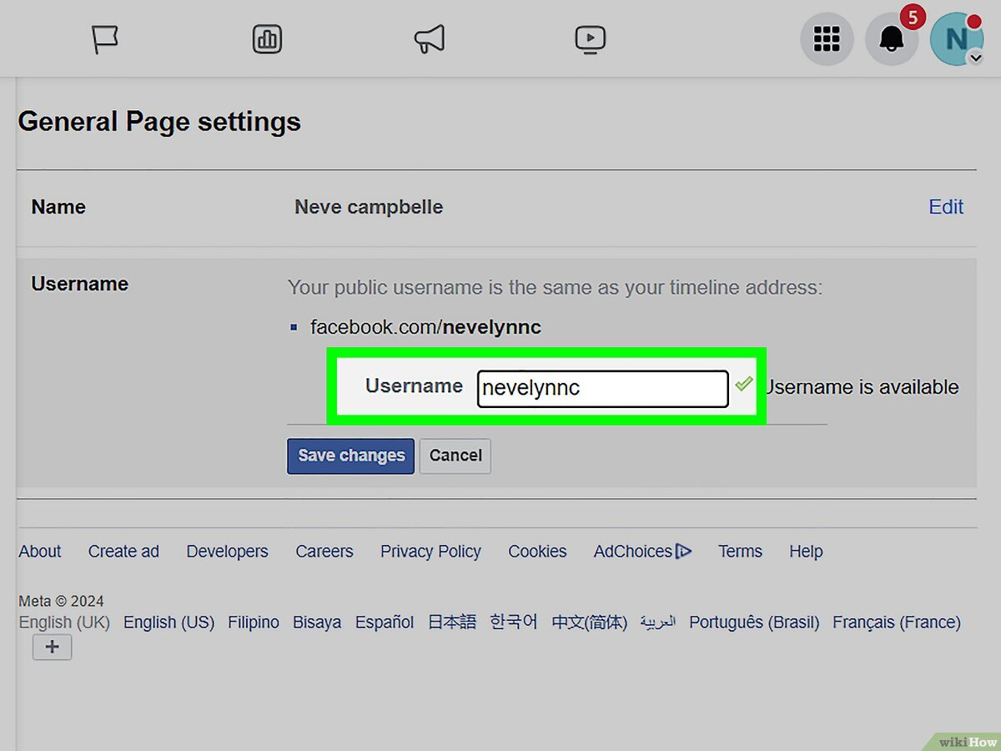








Step 5: Managing Your Page
05
Team Management & Settings
Add Page Team Members
Go to Settings > Page access
Click Add New to invite team members
Assign Roles
Admin
Editor
Moderator
Full control
Create & edit
Manage comments
Page Settings
Configure notification preferences
Set up page security options
Pro Tip
Only grant admin access to trusted team members who need full control of your page

Slide 9














Best Practices for Professional Pages
Content Strategy
Engagement Tips
Audience Growth
Post 3-5 times per week
Respond to comments within 24 hours
Invite friends to like your page
Mix of 80% value, 20% promotion
Boost high-performing posts
Ask questions in posts
Run targeted ads to reach new audiences
Use video, images, stories
Use Facebook Stories for behind-the-scenes
Analyze peak engagement times
Encourage user-generated content
Create interactive polls
Consistency is key - maintain a regular posting schedule and brand voice across all content

Slide 10








Summary and Next Steps
Key Steps Recap
1
Create Page & Add Info
2
Add Profile & Cover Photos
3
Complete Page Details
Why It Matters
4
Customize Templates & Tabs
5
Manage Team & Settings
Increases brand visibility
Builds community around your brand
Direct customer service channel
Next Steps
Valuable audience insights
Create a content calendar for consistent posting
Set up Facebook Insights to track performance
Start Creating Your Page
Plan your first promotional campaign

