Slide 1




Introduction to Marketing & Digital Marketing
Digital Marketing Course - Month 1, Weeks 1-2

Slide 2
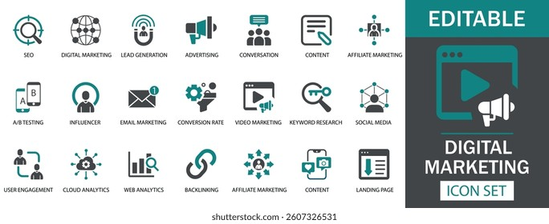




What is Marketing?
Marketing refers to the activities a company undertakes to promote the buying or selling of a product or service.
Advertising
Selling
Delivering
Customer Engagement

Slide 3








Functions of Marketing
Identifying customer needs
Identify Needs
Creating a product/service
Support
Marketing Functions
Create Product
Promoting the offering
Delivering it to customers
Post-sale service and support
Promote

Slide 4
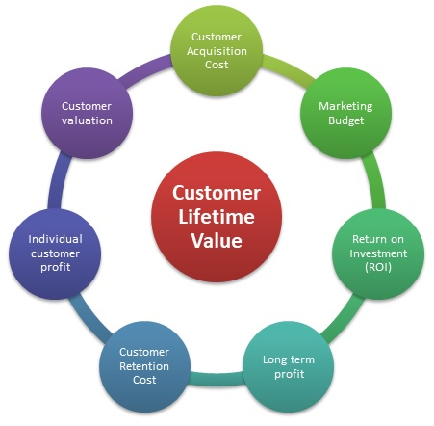



Customer-Centric Marketing
Customer-centric marketing focuses on providing a positive customer experience.
Key Benefits:
Builds customer loyalty
Improves retention
Increases lifetime value

Slide 5












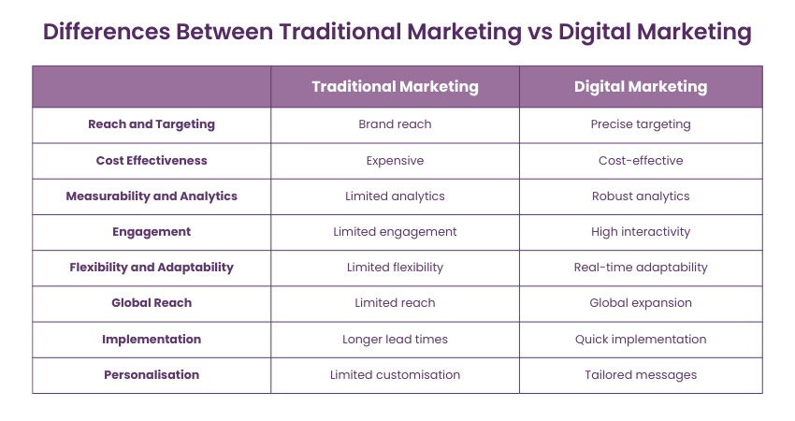
Traditional vs. Digital Marketing
Traditional Marketing
Digital Marketing
Print Media
Websites
Television & Radio
Social Media
Billboards
Email
One-way Communication
Two-way Interaction
Expensive & Less Measurable
Cost-effective
Real-time Analytics

Slide 6







Marketing Funnel
Customer becomes aware of your brand
Awareness
Customer shows interest in your product
Interest
Customer evaluates your offering
Consideration
Customer shows purchase intent
Intent
Customer makes a purchase
Purchase
Customer becomes a repeat buyer
Loyalty
Customer recommends your brand
Advocacy

Slide 7
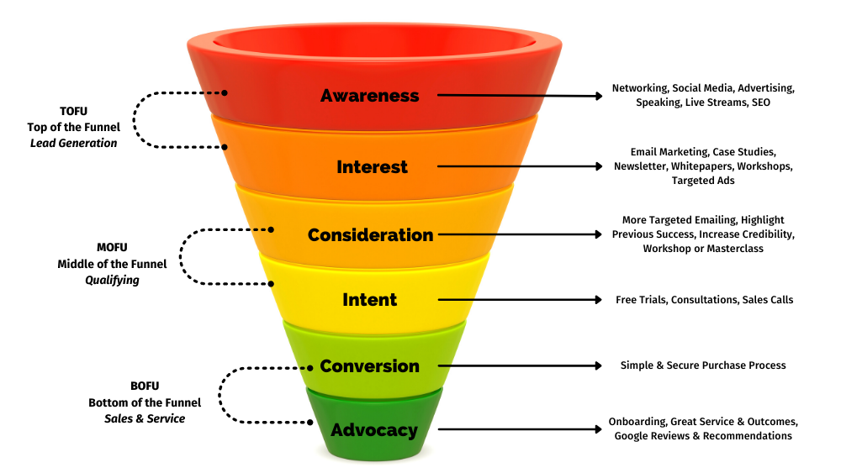
Marketing Funnel

Slide 8
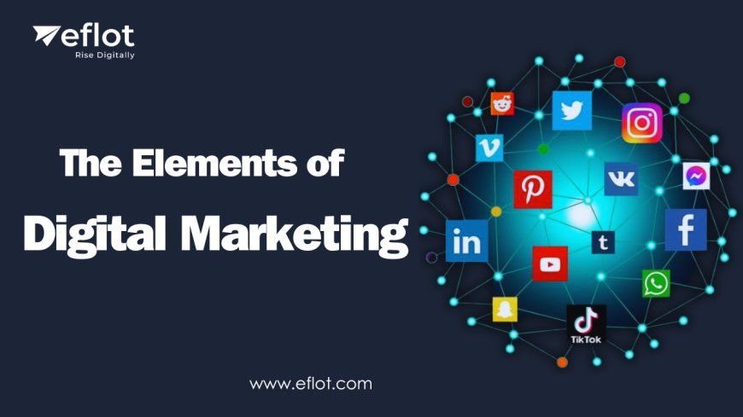


What is Digital Marketing?
Digital marketing is the use of digital channels, platforms, and technologies to promote or market products and services to consumers and businesses.
Digital Channels
Multiple Platforms
Advanced Technologies
Target Audiences

Slide 9





Benefits of Digital Marketing
Digital Marketing Growth Impact
Global reach
Cost-effective
75%
60%
Measurable results
Personalized targeting
40%
25%
Real-time engagement
Reach
Engagement
Conversion
ROI

Slide 10








Types of Digital Marketing
SEO
Content Marketing
Social Media
Email Marketing
Improving website visibility in search engines
Creating valuable content to attract audience
Building brand awareness on social platforms
Direct communication with customers
Affiliate Marketing
Influencer Marketing
Mobile Marketing
Video Marketing
Earning commissions by promoting products
Collaborating with influencers
Reaching customers via mobile devices
Using video content to engage audiences

Slide 11
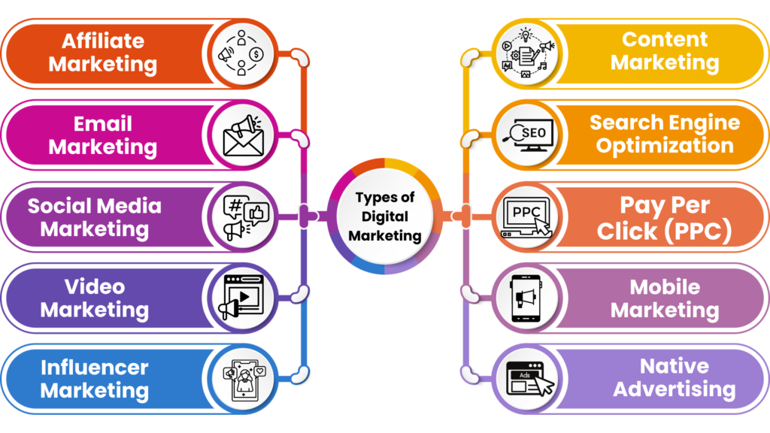
Digital Marketing Types

Slide 12
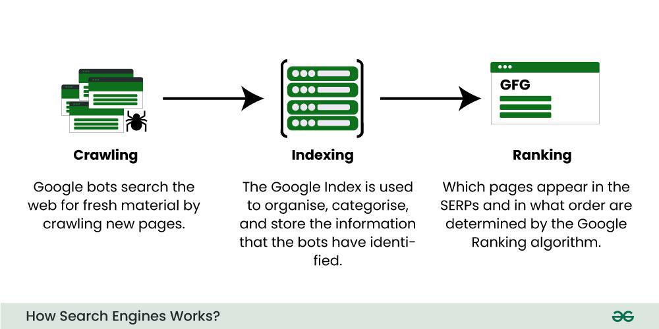



Search Engine Optimization (SEO)
SEO improves your website's visibility in search engines like Google to attract more organic traffic.
Increases organic traffic
Builds brand credibility
Cost-effective long-term strategy

Slide 13





Search Engine Marketing (SEM)
Ad
Best Digital Marketing Tools - 50% Off Today
www.exampletools.com
SEM involves paid advertising to appear on search engine result pages (e.g., Google Ads).
Discover top digital marketing tools with exclusive discounts. Boost your online presence today!
Ad
Digital Marketing Solutions - Free Trial
www.marketsolutions.com
All-in-one platform for social media, email, and analytics. Start your free trial now!
Immediate results
Precise targeting
10 Essential Digital Marketing Tools for 2023
www.blogexample.com/marketing-tools
A comprehensive guide to the most effective digital marketing tools for businesses of all sizes...
Measurable ROI
Flexible budget
Digital Marketing Tools Comparison
www.reviewsite.com/tools-comparison
Side-by-side comparison of popular digital marketing tools. Features, pricing, and user reviews...
Paid ads appear at the top of search results, increasing visibility

Slide 14








Content Marketing
Content Marketing Cycle
Creating and sharing valuable content to attract and retain a clearly defined audience.
1
Research & Plan
Identify audience needs and content gaps
2
Create
Develop valuable and engaging content
Content Types
Blog Posts
Videos
3
Distribute
Share across relevant channels
Infographics
Ebooks
4
Analyze
Podcasts
Webinars
Measure performance and optimize

Slide 15
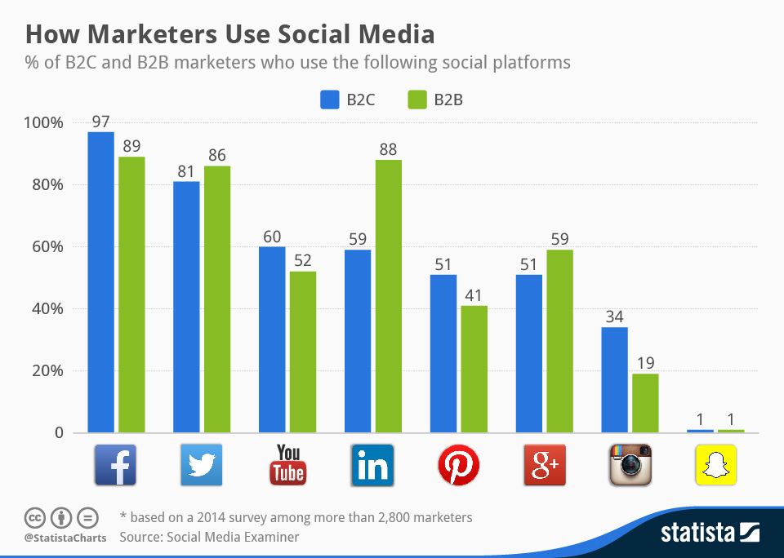






Social Media Marketing (SMM)
Social Media Usage by Marketers
Using platforms like Facebook, Instagram, and LinkedIn to build brand awareness and drive traffic.
Key Platforms
Facebook
Instagram
LinkedIn
Twitter
YouTube
TikTok
94%
76%
53%
Use Facebook
Use Instagram
Use LinkedIn

Slide 16





Email Marketing
Sending emails to prospects and customers to build relationships and drive conversions.
Effective Email Campaign Example
YourBrand
Special Offer Just for You!
Best Practices
Hi [Customer Name],
Thank you for being a loyal customer. As a token of our appreciation, we're offering you an exclusive 20% discount on your next purchase.
Personalization
Segmentation
© 2023 YourBrand. All rights reserved.
Mobile Optimization
4200%
59%
Average ROI
Higher Conversion

Slide 17











Affiliate & Influencer Marketing
Affiliate Marketing
Influencer Marketing
Earning commissions by promoting other companies' products
Collaborating with influencers to promote your brand to their audience
Unique tracking links
Leverages established trust
Commission-based rewards
Expands brand reach
Performance tracking
Creates authentic content
Example: Influencer Post
@influencer
Loving this new product from @brand! #ad #sponsored
Example: Affiliate Link

Slide 18









Mobile & Video Marketing
Mobile Marketing
Video Marketing
Reaching customers through mobile apps, SMS, or mobile-optimized websites
Using video content on platforms like YouTube or Instagram to engage audiences
Mobile apps
YouTube marketing
SMS campaigns
Instagram Reels
Mobile-optimized sites
Live streaming
Mobile Usage Statistics
63%
5.3B
Mobile traffic
Mobile users
Video Engagement Trends
85%
2.5B
Higher engagement
Monthly YouTube users
Shopping App

Slide 19




Analytics and Reporting
Tools like Google Analytics help measure campaign performance and user behavior.
Analytics Dashboard
Monthly Traffic
Traffic Sources
4.8K
4.0K
Organic 35%
Key Metrics to Track
3.2K
2.4K
100%
Social 30%
Traffic
Conversion Rates
Email 20%
Paid 15%
Jan
Feb
Mar
Apr
Engagement
ROI
4.2%
3:45
285%
Conversion Rate
Avg. Session
ROI

Slide 20




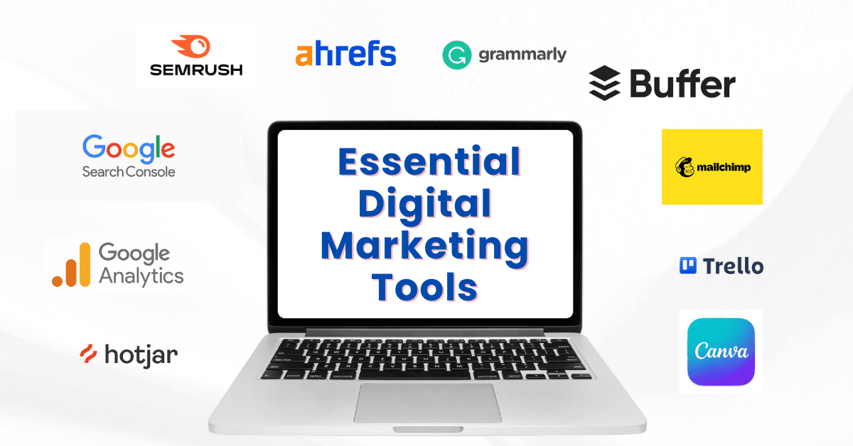
Digital Marketing Tools
Google Analytics
Mailchimp
Canva
Tracks website traffic and user behavior
Email marketing automation platform
Graphic design for social media and marketing
SEMrush
Ahrefs
Buffer
SEO and competitive analysis tool
Backlink analysis and SEO research
Social media scheduling and management

Slide 21











Paid vs. Organic Marketing
Organic Marketing
Paid Marketing
SEO
Google Ads
Social Media Posts
Facebook Ads
Content Marketing
Sponsored Content
Advantages
Advantages
Long-term results
Immediate results
Builds trust & credibility
Precise targeting
Cost-effective over time
Measurable ROI
Disadvantages
Disadvantages

Slide 22




Challenges in Digital Marketing
Ad Blockers
Privacy Regulations
Software that prevents ads from displaying on websites, reducing ad visibility and campaign reach.
Laws like GDPR and CCPA limit data collection and targeting capabilities, requiring compliance adjustments.
Impact:
47% of internet users use ad blockers
Impact:
Increased compliance costs and restrictions
High Competition
Changing Algorithms
Increased digital adoption leads to crowded marketplaces, making it harder to stand out and capture attention.
Frequent updates to search engine and social media algorithms affect content visibility and reach.

Slide 23


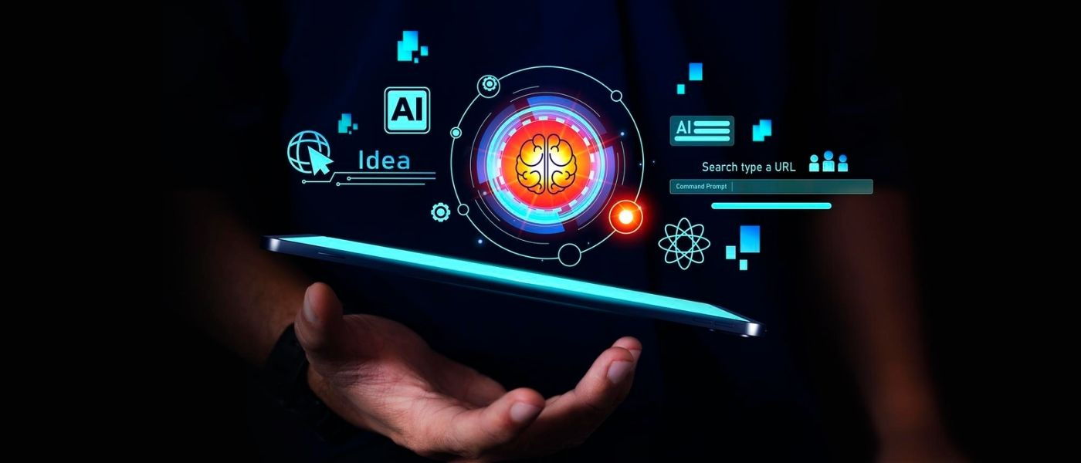
Future of Digital Marketing
AI and Automation
Voice Search
Artificial intelligence will automate repetitive tasks and enhance personalization at scale.
Optimizing for voice queries will become essential as voice assistants continue to gain popularity.
Growth:
40% annual increase in AI adoption
Usage:
50% of all searches will be voice by 2025
Video-first Content
Personalization
Short-form video and live streaming will dominate content strategies across all platforms.
Hyper-personalized experiences based on user behavior and preferences will become standard.

Slide 24


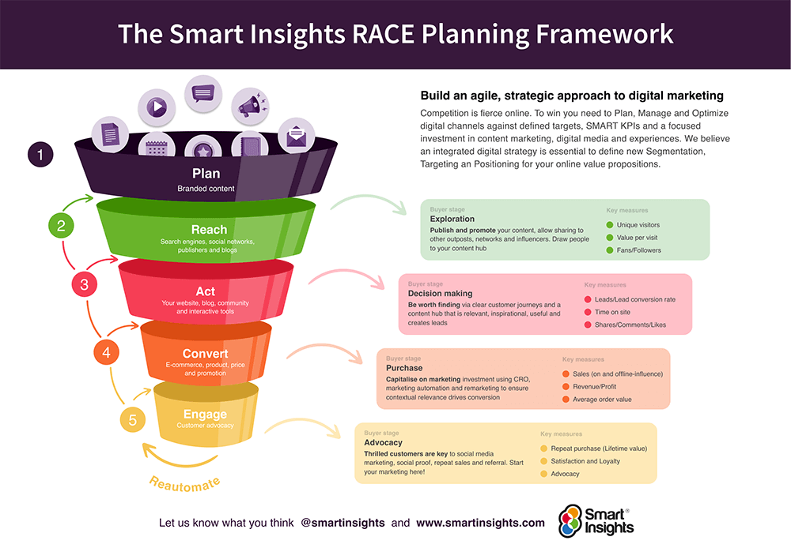
Digital Marketing Strategy
1
2
3
4
5
Define Goals
Know Audience
Choose Platforms
Create Content
Analyze Results
Set clear, measurable objectives
Research target demographics
Select appropriate channels
Develop engaging materials
Measure performance and optimize

Slide 25


Career Opportunities
SEO Specialist
Social Media Manager
Optimize websites to improve search engine rankings and drive organic traffic.
Create and manage content across social platforms to build brand awareness.
Key Skills:
Key Skills:
Keyword Research
Analytics
Technical SEO
Content Creation
Community Management
Analytics
Growth:
20% annual job growth
Demand:
High across all industries
Content Creator
Digital Ads Expert

Slide 26



Case Study: Nike Digital Campaign
Campaign Strategy
Nike Campaign Elements
Personalized email campaigns based on customer behavior
NIKE
Targeted ads across digital platforms
Customer Behavior Analysis
Data-driven customer segmentation
Audience Segmentation
Campaign Results
Personalized Email Content
30%
↑
↑
Increased Engagement
Boosted Online Sales
Enhanced Brand Loyalty

Slide 27






Summary and Activity/Homework
Summary
Activity / Homework
Compare a traditional and a digital marketing campaign for the same product.
Marketing is essential for connecting with and serving customers
Digital marketing offers cost-effective, measurable, and interactive alternatives
1
Identify tools, costs, reach, and effectiveness
2
Present findings in the next class
Customer-centric strategies help build long-term value

