Slide 1
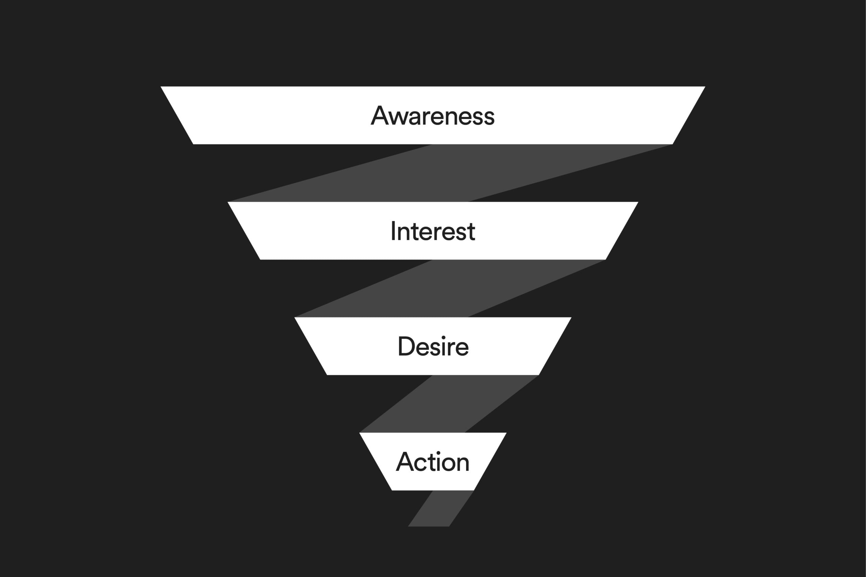



Marketing Funnel & AIDA Model
Digital Marketing & E-commerce
Apex IT Skills Center Zafarwal
Module 2: Digital Marketing
Course Mentor: Jamshaid Akhtar

Slide 2





What is a "Model" in Digital Marketing?
Definition
Why Models Matter
Structured framework explaining customer thinking
Without a Model
With a Model
Shows customer journey from first contact to purchase
Random posting
Planned marketing
Guides content and ad design at each stage
Wasted ad budget
Measurable results
Focus only on selling
Repeatable process
No trust building
Customer-focused
A model doesn't guarantee success, but it reduces mistakes

Slide 3






Common Marketing Models Used in Digital Marketing
AIDA is not the only model, but it's the most beginner-friendly
AIDA Model
Marketing Funnel
Customer Journey
STP Model
Awareness → Interest → Desire → Action
Top (Awareness) → Middle (Consideration) → Bottom (Conversion)
Awareness → Research → Comparison → Purchase → Loyalty
Segmentation → Targeting → Positioning
4Ps Model
Product → Price → Place → Promotion

Slide 4

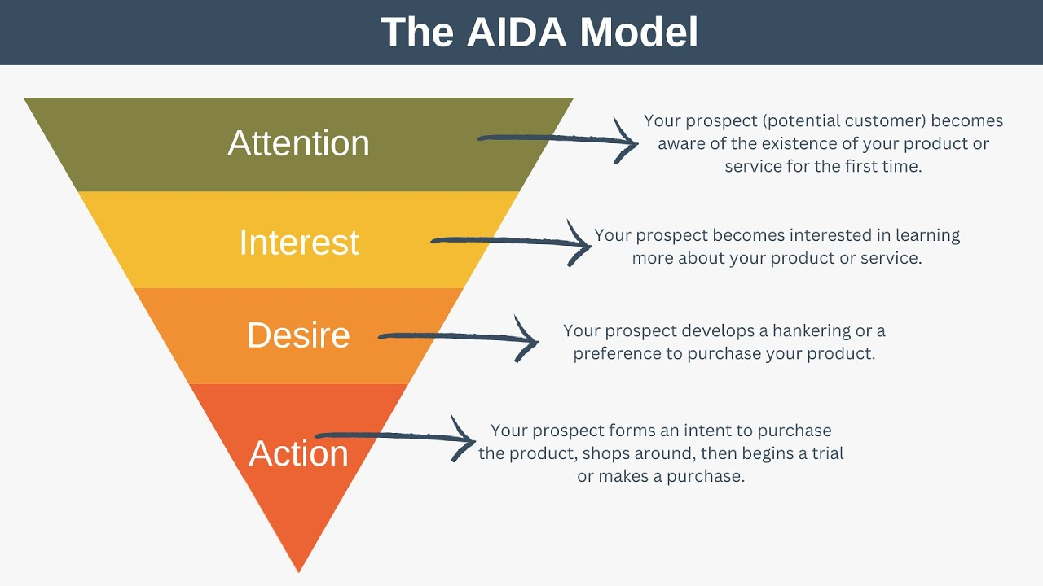

What is the AIDA Model?
Definition
The AIDA Model explains the psychological journey of a customer before making a purchase decision.
A
Awareness
Let people know you exist
I
Interest
Make them care about your solution
D
Desire
Make them want your product
A
Action
Tell them what to do next
Each stage needs different content, messages, and ad objectives

Slide 5














AIDA Model Explained with Digital Examples
A
Awareness
I
Interest
Purpose
Purpose
Introduce brand/product/service
Build curiosity, show relevance to customer's problem
Best Content Types
Best Content Types
Educational posts
How-to posts
Reels
Demo videos
Short videos
Problem-solution content
Informative ads
Examples
Examples
"How we repair phones in under 30 minutes"
"5 mistakes people make while buying laptops"
"Why most students fail to learn computer skills"
"Did you know this phone problem can be fixed cheaply?"
Common mistake: Selling in awareness stage
D
A
Build trust, show value, create emotional connection
Convert interest into sale or inquiry
"Message us on WhatsApp now"
Student success stories
"Enroll today – limited seats"
Customer reviews
Limited-time offers
If you don't ask for action, people won't take it

Slide 6
AIDA Model in Social Media Marketing
Different platforms require different approaches for each AIDA stage
Match content type to platform strengths at each AIDA stage for maximum impact

Slide 7









Real Case Study
Online IT Course (Local Example)
Local IT institute offering a digital marketing course
A
Awareness
I
Interest
Facebook
Facebook
Reels: "Why digital skills matter in 2025"
Posts explaining course modules
TikTok
Career paths information
Short videos about freelancing
Short demo videos of classes
Goal
Reach students and parents
A
D
Fewer but serious inquiries
Higher enrollment rate

Slide 8











Hands-On Classroom Activity
Activity 1: AIDA Content Mapping
Activity 2: Identify the Funnel Stage
1
Divide students into groups
Instructions
2
Show students real Facebook posts and ask:
• Which AIDA stage is this?
• Is it correct or wrong?
Assign one business to each group
Mobile repair shop
Online course
Clothing store
Beauty salon
"Limited time offer: 50% off all smartphones! Buy now before stock runs out!" Action
Is this appropriate for the target audience?
3
Each group must create:
1 Awareness post idea
1 Interest post idea
1 Desire post idea
1 Action message
"Did you know? 80% of smartphone users experience battery issues after 1 year." Awareness
What type of content should follow this?
A
"See what our customers say about our fast repair service!" Desire
I
D
A
What should come before this stage?
"5 signs your phone battery is dying"
"How we replace batteries safely"
Customer review image
"WhatsApp us for quick repair"

Slide 9





Key Teaching Takeaways and Assignment
Key Teaching Takeaways
Assignment
AIDA is customer-focused, not business-focused
Choose one real business Select a local or online business you're familiar with
Every post must have a clear purpose
Create a 4-step AIDA plan Develop content ideas for each stage: Awareness, Interest, Desire, Action
Ads fail when stages are mixed
Present it in next class Prepare a 5-minute presentation explaining your AIDA strategy
Social media success is planned psychology, not luck
Due: Next class session

