Slide 1
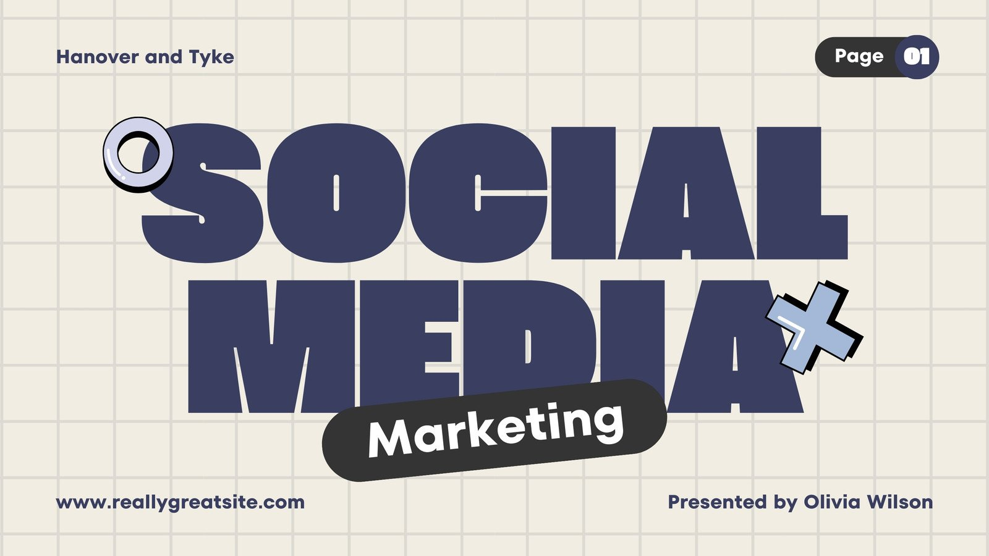




Social Media Marketing, Platform Selection & Facebook Focus
Digital Marketing & E-commerce
Institution:
Apex IT Skills Center Zafarwal
Module:
Module 2: Digital Marketing
Lecture:
Lecture 2: Social Media Marketing, Platform Selection & Facebook Focus
Course Mentor:
Jamshaid Akhtar

Slide 2


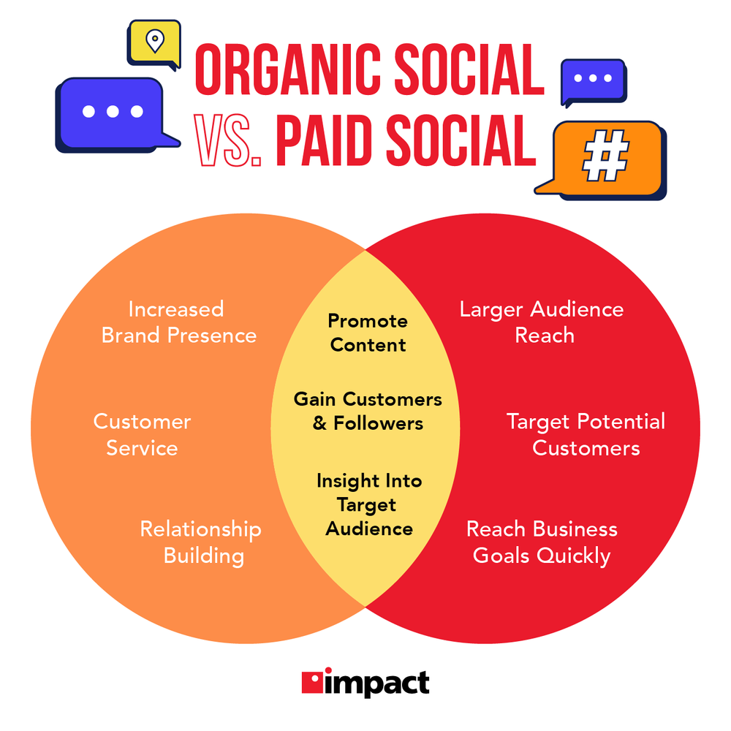




What Is Social Media Marketing?
Social Media Marketing (SMM) is the process of using social media platforms to achieve business goals.
Using social media platforms
To build brand awareness
Engage with the audience
Generate leads and sales
Through content, interaction, and paid advertising
Important Clarification
Social media marketing is not posting randomly
Social media marketing is planned communication with a business goal

Slide 3
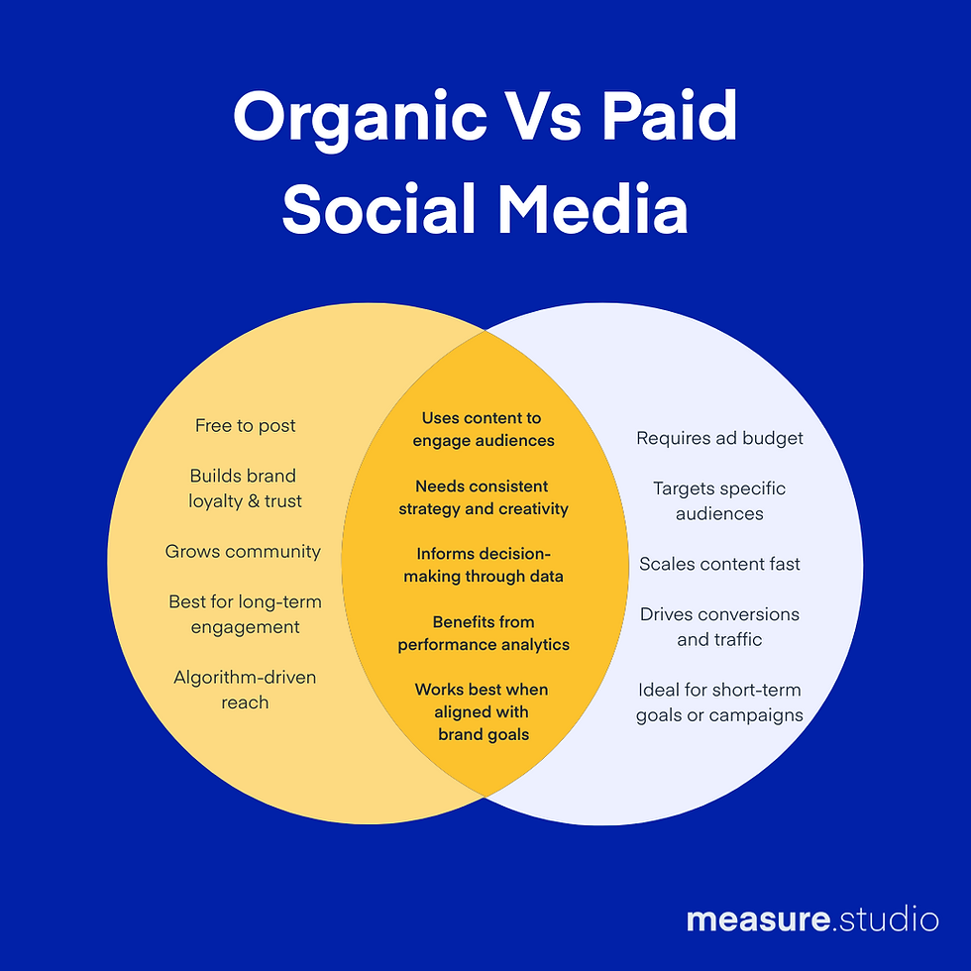




Why Social Media Marketing Is Important Today
Businesses prefer social media because:
Customers already spend time there
Direct communication is possible
Results are measurable
Works well for small and local businesses
4.9B
Real Example
A shopkeeper cannot afford a TV ad, but can run a Facebook ad for ₨500 and reach nearby customers.
People use social media worldwide

Slide 4









Organic vs Paid Social Media Marketing
Organic Marketing
Paid Marketing
Free posting
Advertisements
Builds trust
Fast results
Slow but long-term
Targeted reach
Examples:
Examples:
Facebook posts
Reels
Stories
Facebook ads
TikTok ads
Click-to-WhatsApp ads
Professional Rule: Successful businesses use both, not one.

Slide 5





Social Media Platforms Overview
Not every platform is suitable for every business. Platform selection depends on your business type, target audience, content format, and business goals.
Facebook
Instagram
3.07B
2.11B
2.4B
500M
Monthly Active Users
Daily Active Users
Monthly Active Users
Daily Stories Users
TikTok
LinkedIn
1.6B
1.2B
310M
Monthly Active Users
Total Registered Users
Monthly Active Users
WhatsApp Business
3.3B
200M
Monthly Active Users
Business Users
Platform selection is critical for social media marketing success. Choose based on your business goals and target audience.

Slide 6






Facebook - Platform Details and User Statistics
Facebook
3.07B
2.11B
Monthly Active Users
Daily Active Users
Key Features for Businesses
Facebook Pages - Business profiles
Facebook Groups - Community building
Meta Business Suite - Management tools
Best For
Ads Manager - Advanced advertising
Local Businesses
Institutes
Integration - Instagram & WhatsApp
Service Providers
Online Sellers
All Age Groups
Small Budgets

Slide 7
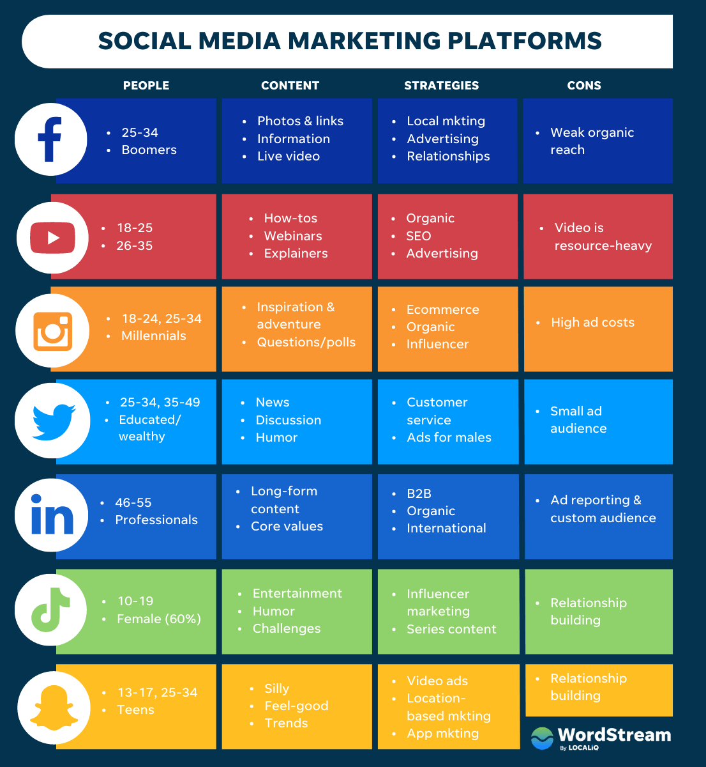






Instagram - Platform Details and User Statistics
Instagram
2.4B
500M
Monthly Active Users
Daily Stories Users
Key Features for Businesses
Visual Content - Photos & videos
Stories - 24-hour content
Reels - Short video format
Best For
Shopping Features - Product tags
Fashion Brands
Beauty Products
Explore Page - Discovery
Lifestyle Brands
Visual Products
Younger Audience
Brand Awareness

Slide 8
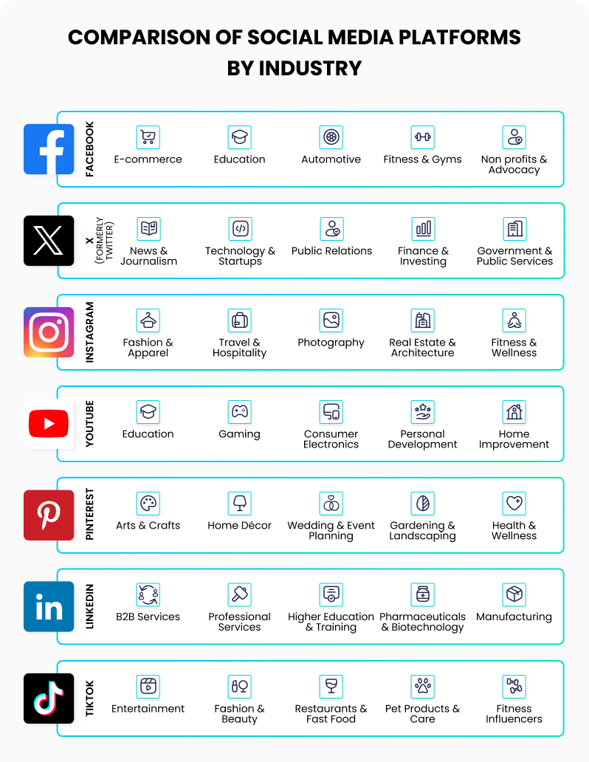






TikTok - Platform Details and User Statistics
TikTok
1.6B
1B+
Monthly Active Users
Downloads Worldwide
Key Features for Businesses
Short Videos - 15-60 seconds
Algorithm - Strong content discovery
Sound Library - Trending audio
Best For
Hashtag Challenges - Viral campaigns
Brand Awareness
Trend-Based Content
TikTok Shop - In-app purchasing
Younger Audience
Entertainment Brands
Creative Campaigns
Viral Marketing

Slide 9
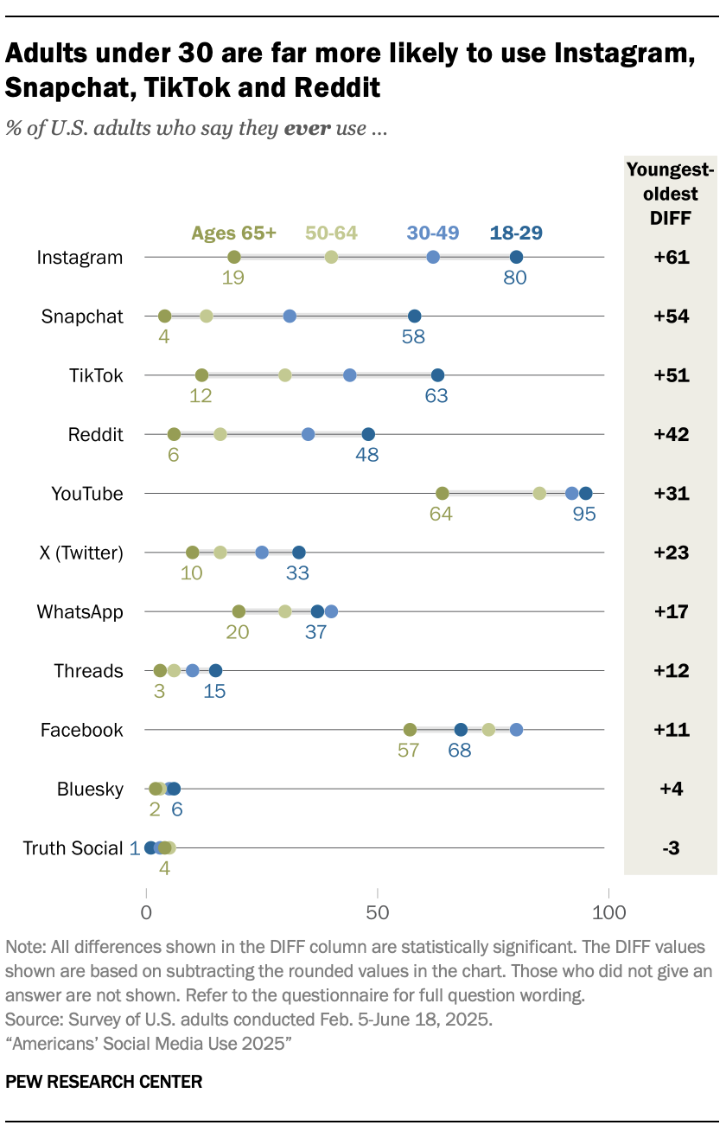






LinkedIn - Platform Details and User Statistics
LinkedIn
1.2B+
310M
Total Registered Users
Monthly Active Users
Key Features for Businesses
Company Pages - Business profiles
LinkedIn Articles - Thought leadership
LinkedIn Groups - Industry discussions
Best For
LinkedIn Ads - Professional targeting
Corporate Services
B2B Marketing
Sales Navigator - Lead generation
Professional Branding
Recruitment
Industry Experts
Thought Leadership

Slide 10
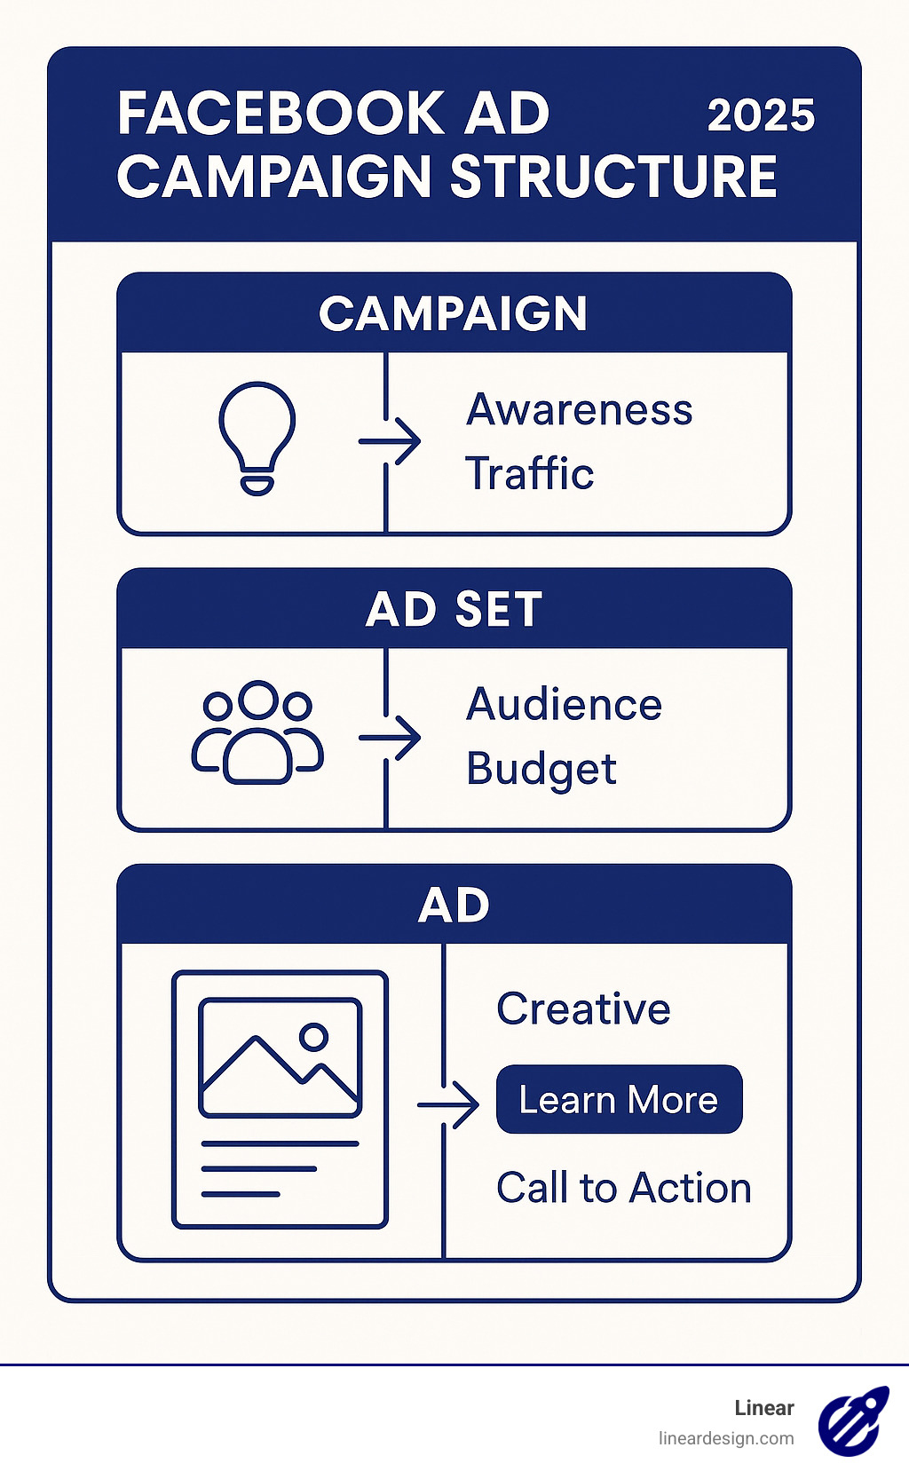






WhatsApp Business - Platform Details and User Statistics
WhatsApp Business
3.3B
200M
Monthly Active Users
Business Users
Key Features for Businesses
Business Profile - Contact info & location
Automated Messages - Quick replies
Broadcast Lists - Bulk messaging
Best For
Messaging Statistics - Performance metrics
Direct Sales
Customer Support
WhatsApp API - Advanced integrations
Repeat Customers
Local Businesses
Service Providers
Personalized Marketing

Slide 11





Platform Selection Guide
Platform selection depends on your business type, target audience, content format, and business goals.
Business Type
Target Audience
Local businesses → Facebook
All age groups → Facebook
Fashion/Beauty → Instagram
Younger audience → Instagram/TikTok
B2B Services → LinkedIn
Professionals → LinkedIn
Entertainment → TikTok
Existing customers → WhatsApp
Content Format
Business Goal
Visual content → Instagram
Brand awareness → TikTok/Instagram
Short videos → TikTok/Reels
Lead generation → Facebook/LinkedIn
Professional articles → LinkedIn
Direct sales → WhatsApp/Facebook
Direct messaging → WhatsApp
Customer support → WhatsApp
Real Case Study
Bakery Business tried LinkedIn → No results
Switched to Facebook → More engagement and orders
Reason: Customers visit Facebook for food, offers, and local businesses — not LinkedIn.

Slide 12
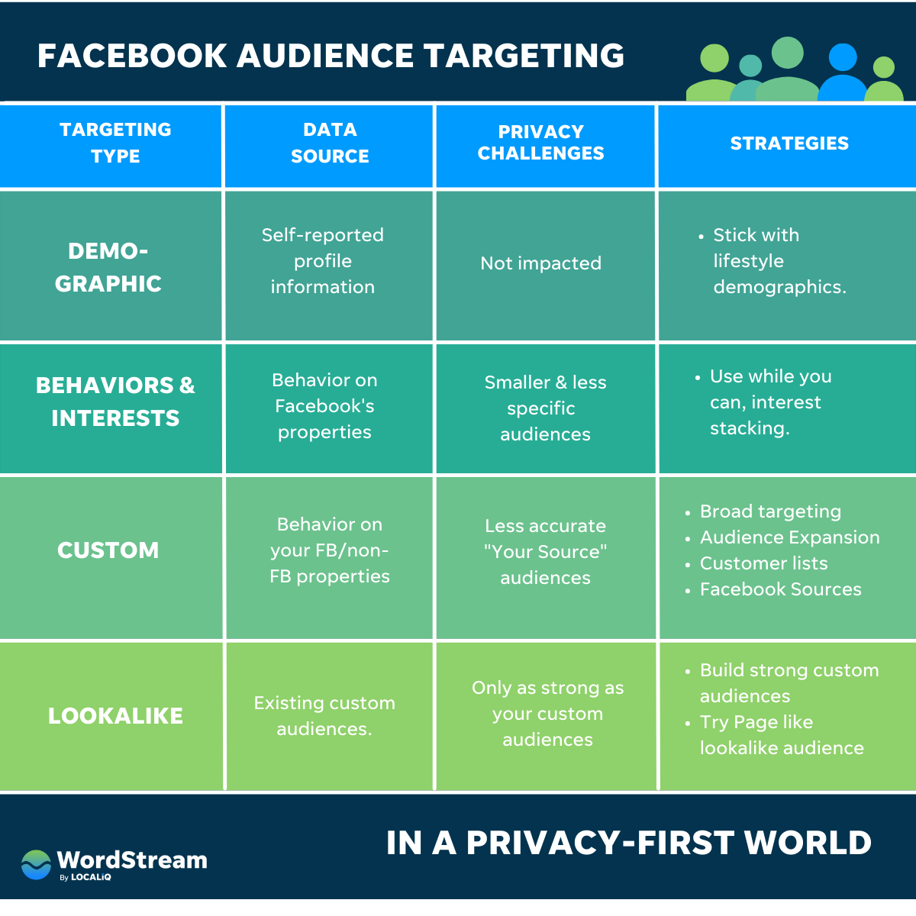











Why Facebook Is the Core Platform
Facebook is not just a platform — it is a complete business ecosystem.
Audience Size
Advertising Power
All age groups • Parents • Students • Professionals
Detailed targeting • Small budget friendly
Business Tools
Integration
Page insights • Message automation • Catalog and CTA buttons
One ad → Facebook + Instagram + WhatsApp
Facebook Business Ecosystem Includes:
Facebook Pages
Facebook Groups
Meta Business Suite
Teaching Insight
Ads Manager
Instagram
WhatsApp
If a student learns Facebook marketing properly, learning other platforms becomes easy.

Slide 13








Facebook Algorithm - How It Works
What Is an Algorithm? A system that decides: Which post appears, To whom, and How often
Engagement
Likes • Comments • Shares • Saves
More engagement = more reach
Watch Time
Videos and Reels
Longer watch = better performance
Relevance
Does the user care about this content?
Past behavior matters
Consistency
Regular posting • Same topic/niche
Case Study
Algorithm Myth Busting
Same Content, Different Reach
Hashtags alone don't guarantee reach
Image post → Low reach
Reel with same message → High reach
Posting daily does not mean success
Reason: Facebook promotes formats that keep users watching.
Valuable content wins

Slide 14





Audience Targeting - The Backbone of Social Media Marketing
What Is Audience Targeting? Showing content or ads only to people who are likely to be interested.
Demographic Targeting
Age • Gender • Location • Education
Age 18-30
Female
Urban areas
Interest-Based Targeting
Hobbies • Pages liked • Online behavior
Tech lovers
Fitness enthusiasts
Travel bloggers
Behavioral Targeting
Online shopping behavior • Device usage
Frequent shoppers
Mobile users
Recent purchases
Buyer vs User Concept (Very Important)
Case Study
Online Course Ads
User
Buyer
Targeted students → Likes but no sales
Student who attends the course
Parent who pays fees
Targeted parents → Fewer clicks, more admissions
Lesson: Always target the decision maker.

Slide 15





Key Takeaways for Students
Strategic Approach
Social media marketing is strategic, not random
Platform Selection
Platform selection decides success or failure
Facebook Foundation
Facebook is the strongest foundation platform
Algorithm Focus
Algorithm rewards value, not effort
Audience Targeting
Correct audience targeting saves money and time
Master social media marketing by focusing on strategy, platform selection, and audience targeting

