Slide 1

Instagram Marketing
Importance, Integration & Audience
Lecture 6

Slide 2



Introduction to Instagram as a Marketing Platform
Visual-first social media platform owned by Meta
Connects businesses through images, videos, stories, reels, and DMs
Image failed to load:
https://sfile.chatglm.cn/images-ppt/ba7d4bfd7185.p...
Beyond fashion/influencers: brand awareness, lead generation, direct sales, community building

Slide 3




Why Have an Instagram Business Account?
Where Attention Is
Visual Trust & Brand Image
Users spend significant time on Instagram daily
Builds credibility through real photos and videos
Direct Customer Communication
Cost-Effective Marketing
DMs, story replies, comments for engagement
Organic reach + paid ads for any budget

Slide 4






Why Connect Instagram with Facebook?
Unified Ad Management
Advanced Audience Targeting
Run ads from one dashboard
Access Facebook's deep audience data
Content Cross-Posting
Business Credibility & Security
Share content automatically across platforms
Verified ownership and better recovery

Slide 5

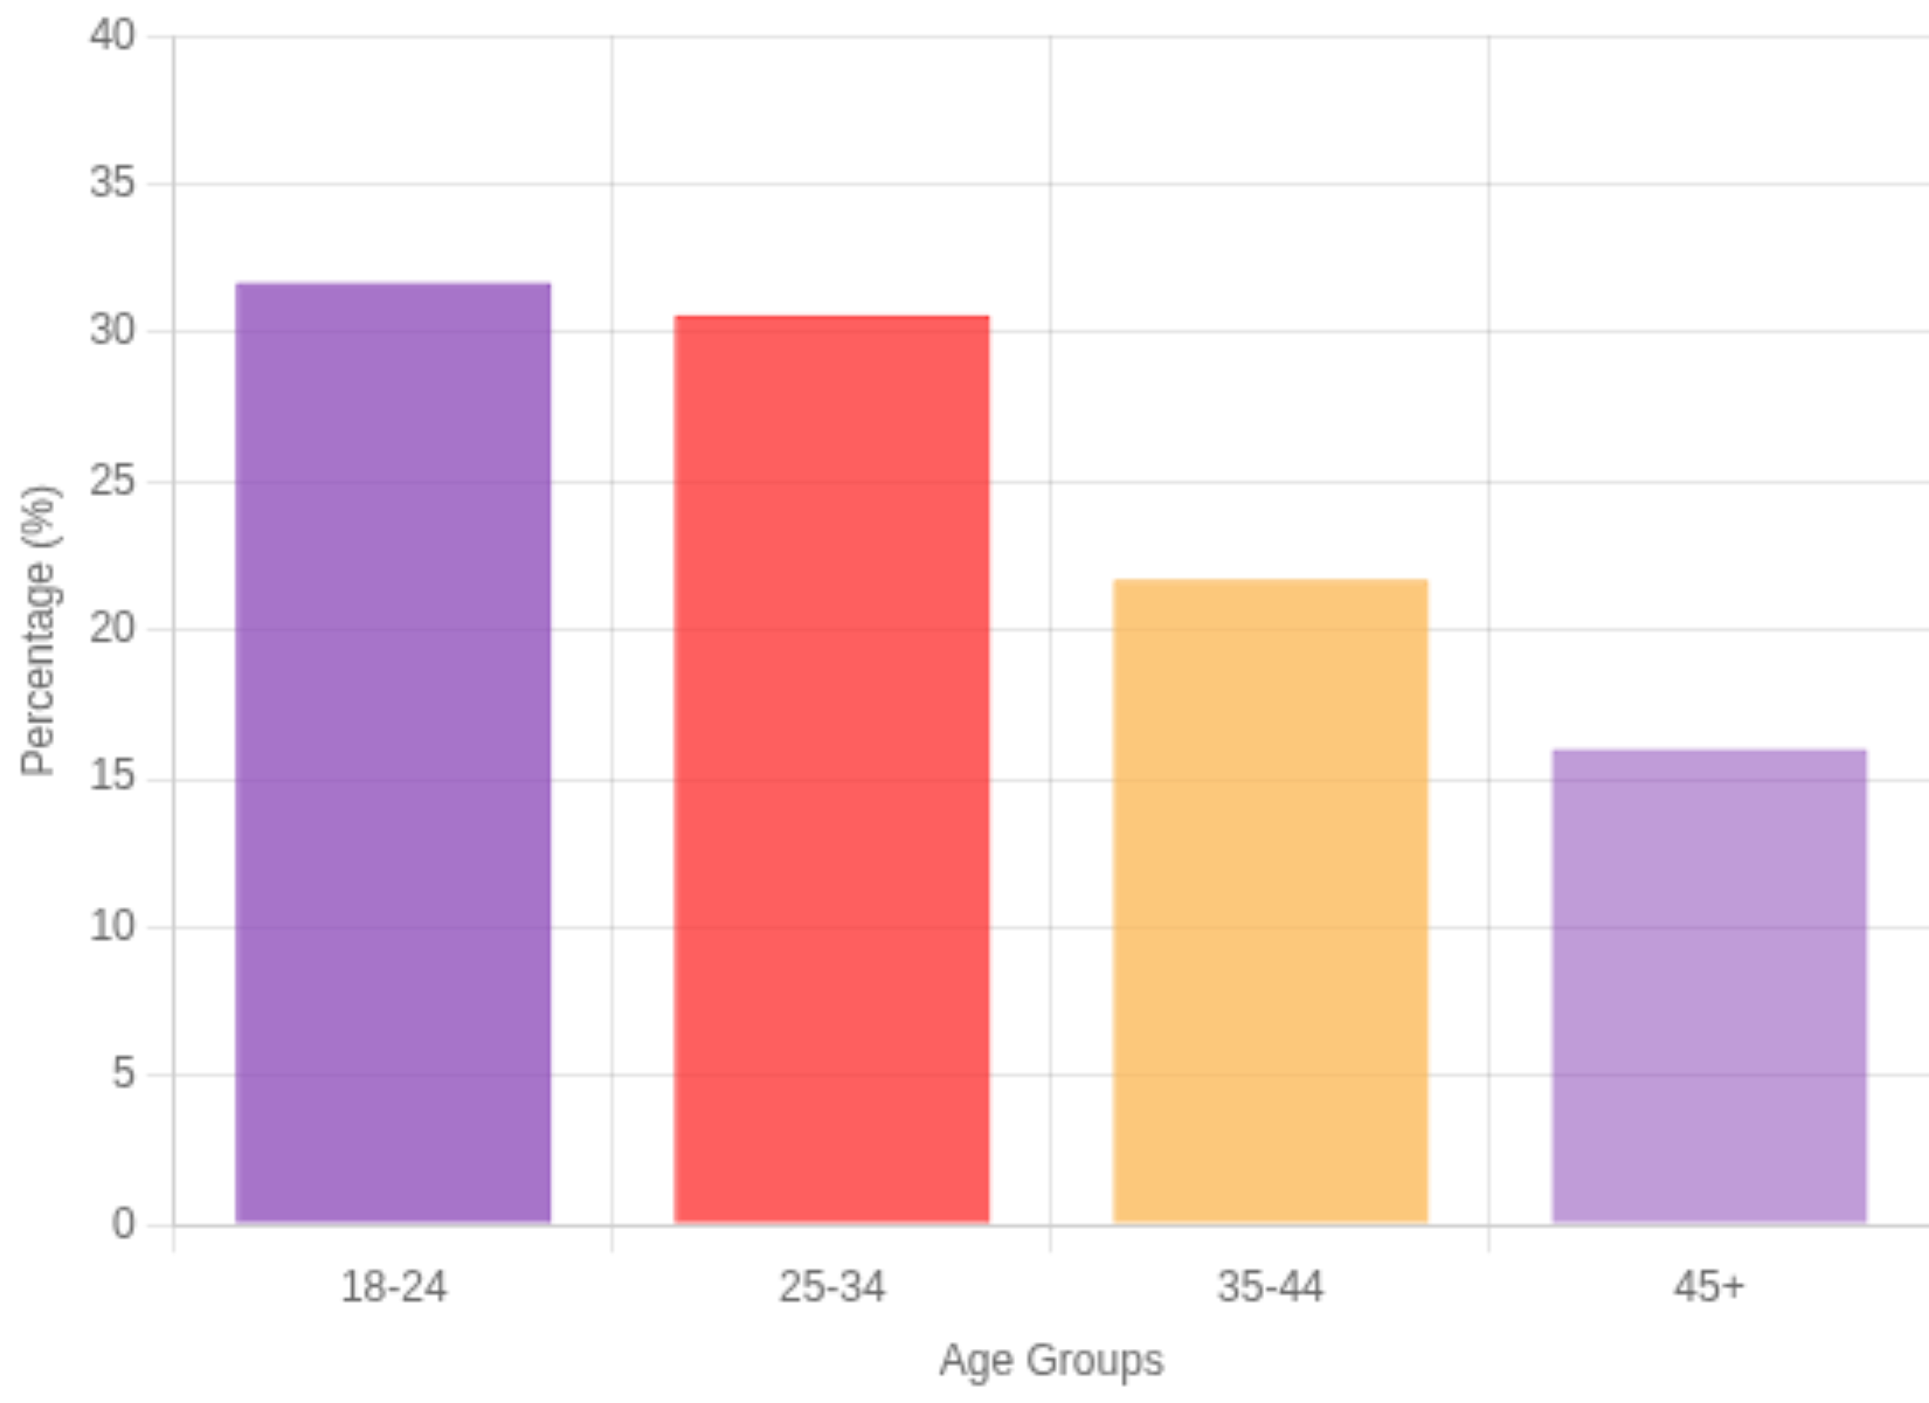


Types of Audience on Instagram
Age Groups
18-24: Trend-driven users
25-34: Core buying group
Instagram User Demographics
35-44: Business owners
45+: Growing segment
Audience by Interest
Education
E-commerce
Food & Fitness
Technology
Local Services
Buyer Behavior
Discover brands
Research products
Impulse purchases
Prefer authentic brands

Slide 6
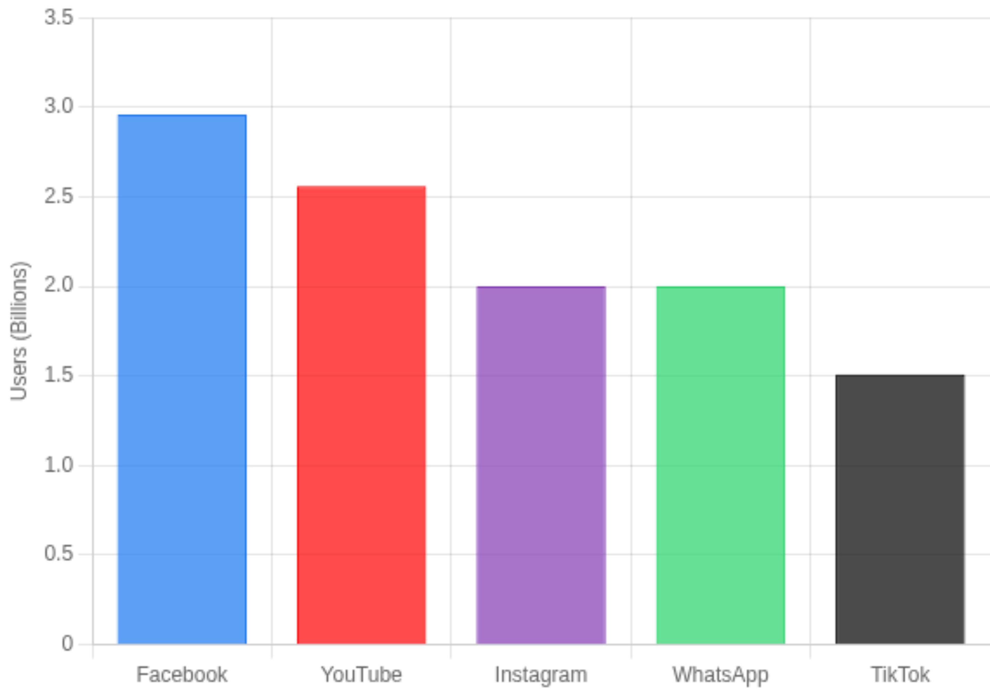




How Big Is Instagram?
2+ Billion
Social Media Platform Comparison
Monthly active users worldwide
Top 5 Platform
Business Following
Most-used social media globally
Most users follow business accounts
Ad Reach
Global Presence
Hundreds of millions reachable
Active in 190+ countries

Slide 7












Instagram in the Marketing Funnel
Top of Funnel
Reels
Explore content
Viral posts
AWARENESS
Reach & Discovery
Middle of Funnel
Stories
CONSIDERATION
Highlights
Engagement & Education
Educational posts
CONVERSION
Sales & Loyalty
Bottom of Funnel
DMs
Offers
Testimonials & Ads

Slide 8






Strategic Takeaway
Where modern customers are
Builds trust visually and emotionally
Strategy
Enables direct communication and fast feedback
Integrates with Facebook for advanced marketing
Instagram
Marketing
Audience
Consistency
Serves both branding and sales objectives
Integration
Success comes from strategy, consistency, integration with Facebook, and understanding the audience

